Slide 1
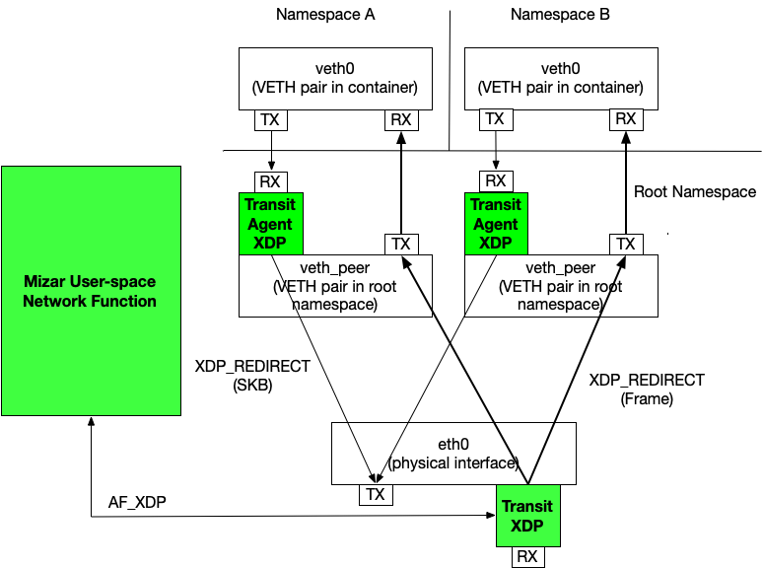
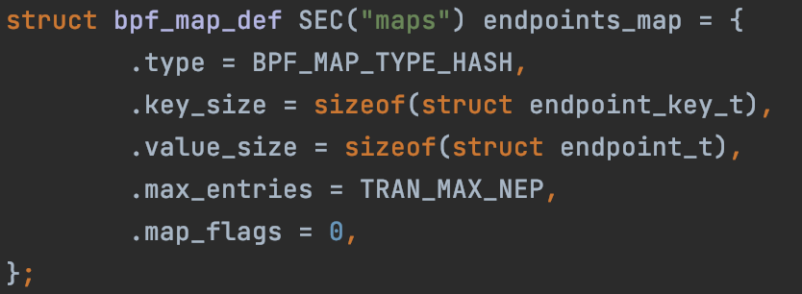

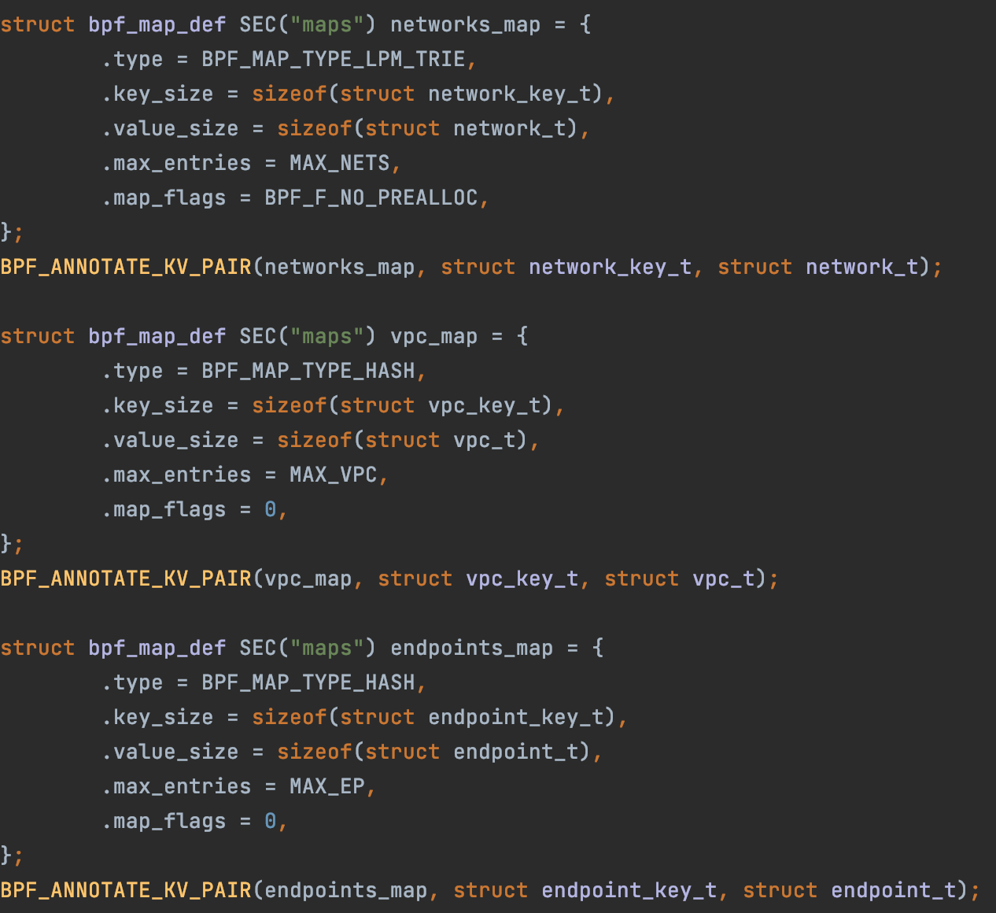

Host
Endpoint
veth0
https://github.com/CentaurusInfra/mizar/blob/dev-next/src/xdp/trn_agent_xdp_maps.h
Endpoint Map
Endpoint IP → [Bouncer IPs]
veth0_root
egress
function
VPC Map
VPC VIN → [Divider IPs]
Network Map
{VPC VIN, Subnet} → [Bouncer IPs]
Endpoint Map
{Endpoint IP} → [Host IP]
ingress
https://github.com/CentaurusInfra/mizar/blob/dev-next/src/xdp/trn_agent_xdp_maps.h

Slide 2
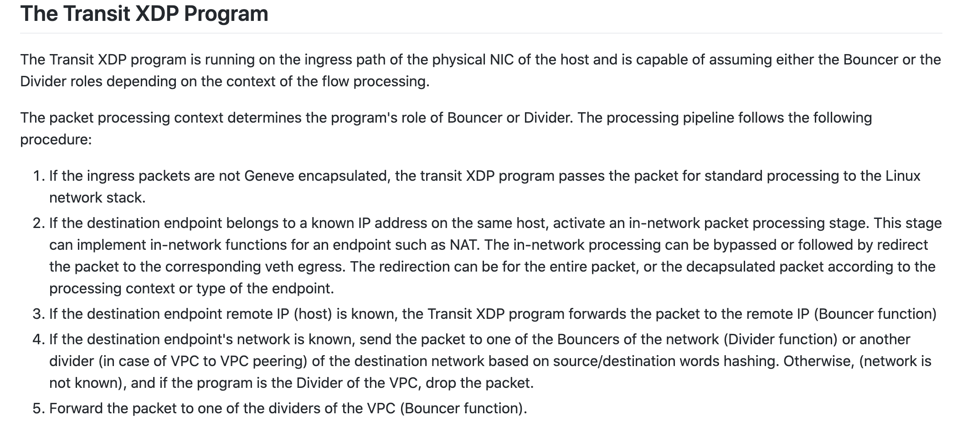
function

Slide 3
Based on https://github.com/CentaurusInfra/mizar/blob/dev-next/docs/design/dp_programability.md
D₀
D₁
VPC Map
VPC VIN → [Divider IPs]
V₀ → [D₀, D₁]
VPC Map
V₀ → [D₀, D₁]
VPC Map
Network Map
{VPC VIN, Subnet} → [Bouncer IPs]
Network Map
Network Map
{V₀,S₀} → [B₀, B₁]
{V₀,S₁} → [B₂, B₃]
{V₀,S₀} → [B₀, B₁]
{V₀,S₁} → [B₂, B₃]
Endpoint Map
{Endpoint IP} → [Host IP]
B₀
B₁
B₂
B₃
VPC Map
VPC Map
VPC Map
VPC Map
V₀ → [D₀, D₁]
V₀ → [D₀, D₁]
V₀ → [D₀, D₁]
V₀ → [D₀, D₁]

Slide 4
D₀
D₁
V₀ → [D₀, D₁]
VPC Map
V₀ → [D₀, D₁]
VPC Map
H₀
Network Map
Network Map
{V₀,S₀} → [B₀, B₁]
{V₀,S₁} → [B₂, B₃]
{V₀,S₀} → [B₀, B₁]
{V₀,S₁} → [B₂, B₃]
P₀
B₀
B₁
veth0
VPC Map
VPC Map
V₀ → [D₀, D₁]
V₀ → [D₀, D₁]
{V₀,S₀} → [B0, B1]
Endpoint Map
Endpoint Map
veth0_root
{V₀,P₀} → [H₀]
{V₀,P₀} → [H₀]
eth0

Slide 5
H₀
H₁
D₀
D₁
P₀
P₁
V₀ → [D₀, D₁]
V₀ → [D₀, D₁]
veth0
veth0
{V₀,S₀} → [B₀, B₁]
{V₀,S₁} → [B₂, B₃]
{V₀,S₀} → [B₀, B₁]
{V₀,S₁} → [B₂, B₃]
{V₀,S₀} → [B₀, B₁]
{V₀,S₀} → [B₀, B₁]
veth0_root
veth0_root
B₀
B₁
eth0
eth0
V₀ → [D₀, D₁]
V₀ → [D₀, D₁]
{V₀,P₀} → [H₀]
{V₀,P₁} → [H₁]
{V₀,P₀} → [H₀]
{V₀,P₁} → [H₁]
{V₀, S₀, P₀} → {V₀, S₀, P₁}

Slide 6
H₀
H₁
D0
D1
P₀
P₁
V₀ → [D₀, D₁]
V₀ → [D₀, D₁]
veth0
veth0
{V₀,S₀} → [B₀, B₁]
{V₀,S₁} → [B₂, B₃]
{V₀,S₀} → [B₀, B₁]
{V₀,S₁} → [B₂, B₃]
{V₀,S₀} → [B₀, B₁]
{V₀,S₁} → [B₂, B₃]
veth0_root
veth0_root
eth0
eth0
B0
B1
B2
B3
V₀ → [D₀, D₁]
V₀ → [D₀, D₁]
V₀ → [D₀, D₁]
V₀ → [D₀, D₁]
{V₀, S₀, P₀} → {V₀, S₁, P₁}
{V₀,P₀} → [H₀]
{V₀,P₀} → [H₀]
{V₀,P₁} → [H₁]
{V₀,P₁} → [H₁]

Slide 7
H₀
H₁
D0
D1
P₀
P₁
V₀ → [D₀, D₁]
V₀ → [D₀, D₁]
veth0
veth0
{V₀,S₀} → [B₀, B₁]
{V₀,S₁} → [B₂, B₃]
{V₀,S₂} → [G]
{V₀,S₀} → [B₀, B₁]
{V₀,S₁} → [B₂, B₃]
{V₀,S₂} → [G]
{V₀,S₀} → [B₀, B₁]
{V₀,S₁} → [B₂, B₃]
veth0_root
veth0_root
eth0
eth0
B0
B1
B2
B3
V₀ → [D₀, D₁]
V₀ → [D₀, D₁]
V₀ → [D₀, D₁]
V₀ → [D₀, D₁]
{V₀, S₀, P₀} → {V₀, S₂, P₂}
{V₀,P₀} → [H₀]
{V₀,P₀} → [H₀]
{V₀,P₁} → [H₁]
{V₀,P₁} → [H₁]

Slide 8
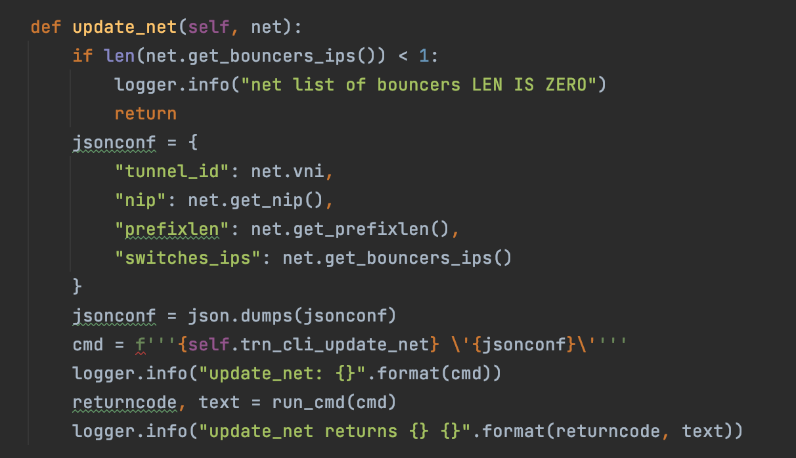
D0
D1
V₀ → [D₀, D₁]
V₀ → [D₀, D₁]
{V₀,S₀} → [B₀, B₁]
{V₀,S₁} → [B₂, B₃]
{V₀,S₂} → [G]
{V₀,S₀} → [B₀, B₁]
{V₀,S₁} → [B₂, B₃]
{V₀,S₂} → [G]
https://github.com/CentaurusInfra/mizar/blob/e8c21f5f262d79dd71cfec5e511a898c7cb1dbe9/mizar/common/rpc.py#L313
B0
B1
B2
B3
V₀ → [D₀, D₁]
V₀ → [D₀, D₁]
V₀ → [D₀, D₁]
V₀ → [D₀, D₁]
{V₀,P₀} → [H₀]
{V₀,P₀} → [H₀]
{V₀,P₁} → [H₁]
{V₀,P₁} → [H₁]

Slide 9
https://github.com/CentaurusInfra/mizar/blob/dev-next/docs/design/puml/create_vpc_workflow.puml

Slide 10
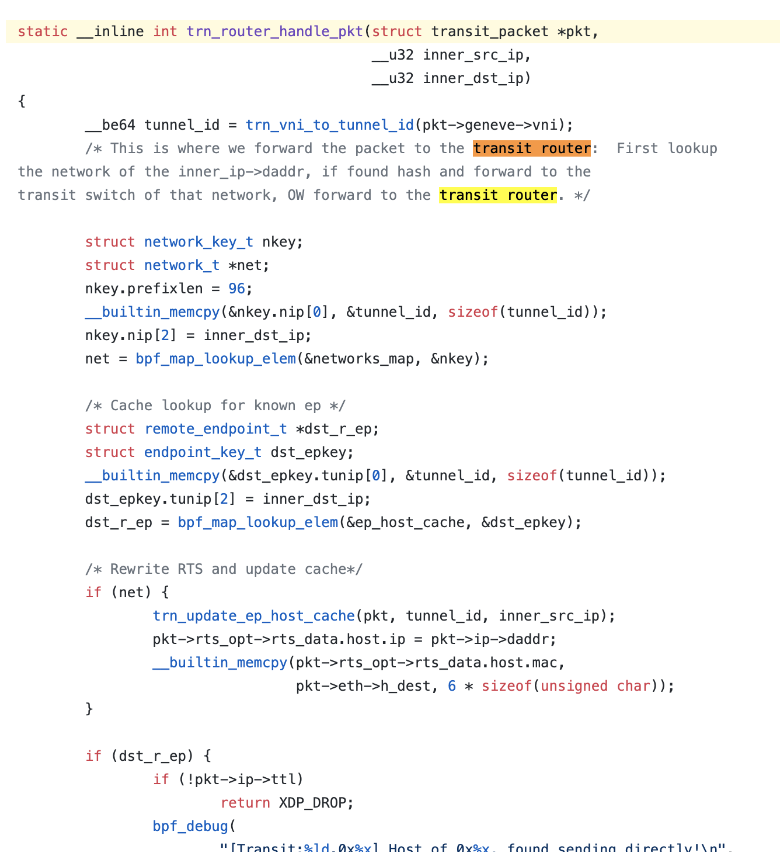
function

